Slide 1
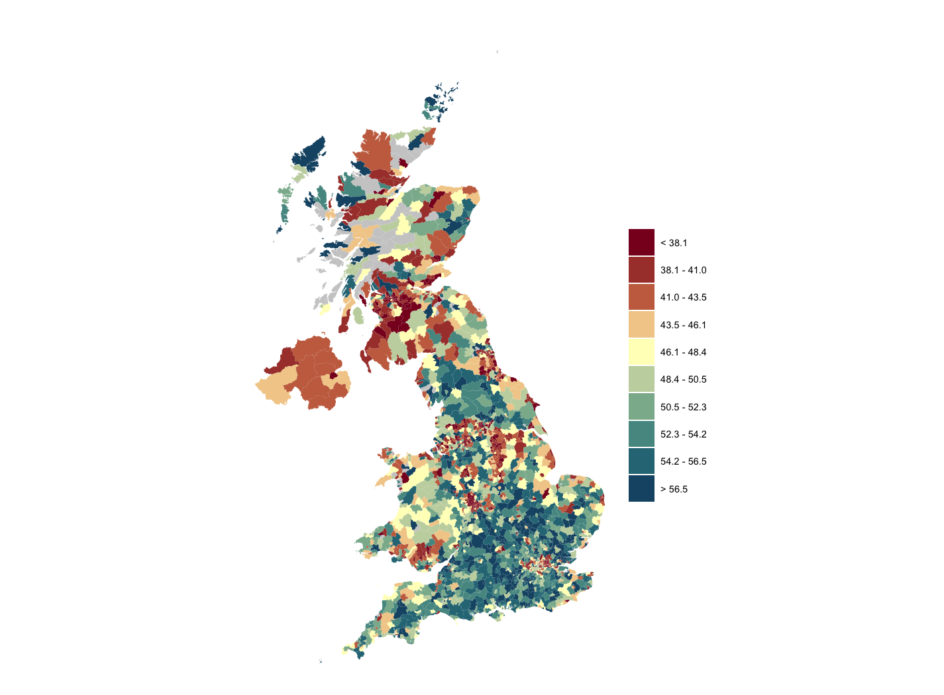
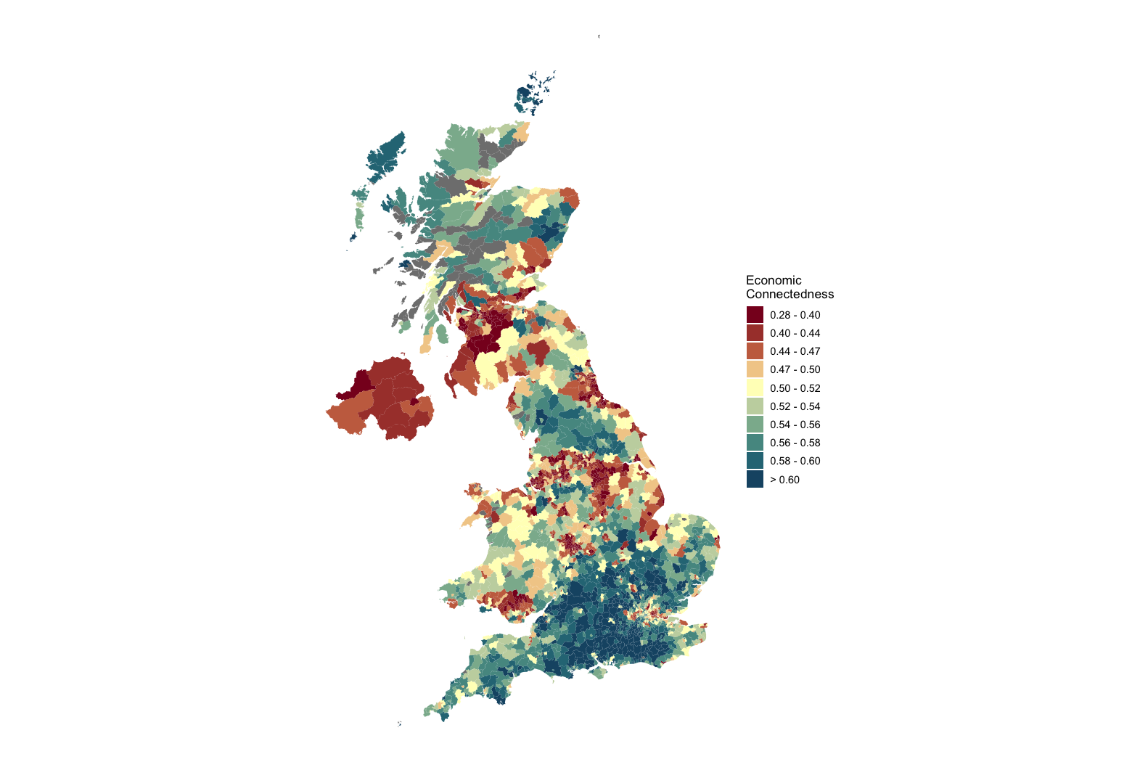

Economic Opportunity and Social Capital
United Kingdom
Upward Mobility
Based on Facebook Data
Economic Connectedness Based on Facebook Data
<.38
<28%
.48
52%
>.56
>60%
Predicted adult income percentile of a child with parents at the 25th percentile of the national income distribution
Share of Above-Median-Income Friends
among Below-Median-Income People
Shading indicates levels of upward mobility and economic connectedness, with red representing lower levels and blue representing higher levels.
Source: Harris, Iyer, Rutter, Chi, Johnston, Lam, Makinson, et al. (2025)

Slide 2
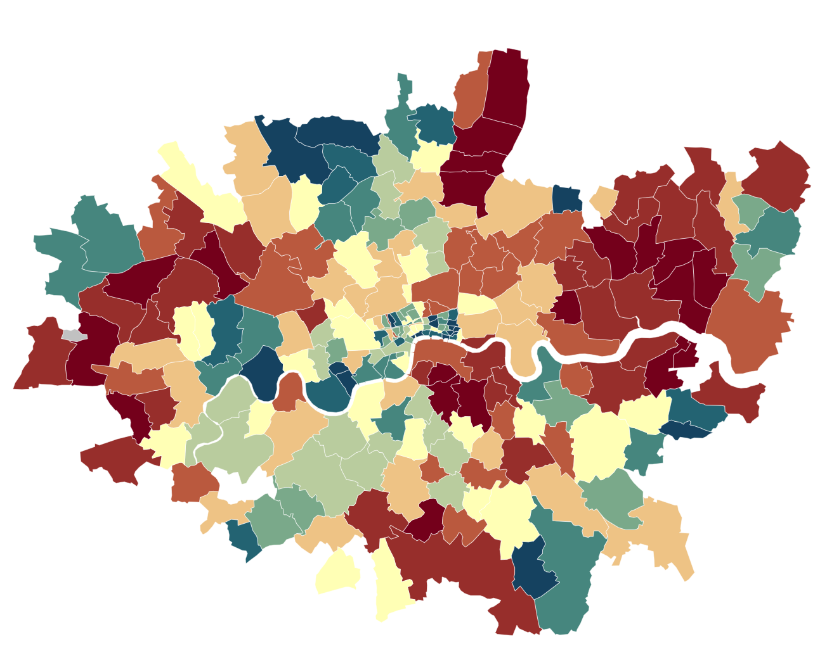
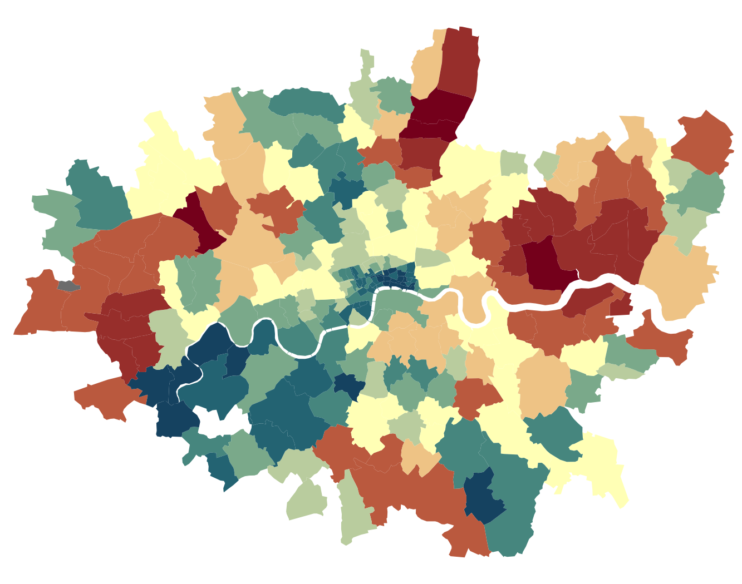
Economic Opportunity and Social Capital
London
Upward Mobility
Based on Facebook Data
Economic Connectedness Based on Facebook Data
<.38
<28%
.48
52%
>.56
>60%
Predicted adult income percentile of a child with parents at the 25th percentile of the national income distribution
Share of Above-Median-Income Friends
among Below-Median-Income People
Shading indicates levels of upward mobility and economic connectedness, with red representing lower levels and blue representing higher levels.
Source: Harris, Iyer, Rutter, Chi, Johnston, Lam, Makinson, et al. (2025)

